Slide 1
4-8: Summing up week 4
By Barbara Oakley, PhD

Slide 2
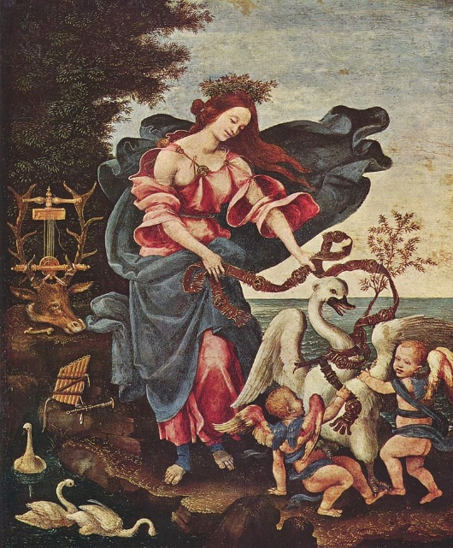

Slide 3
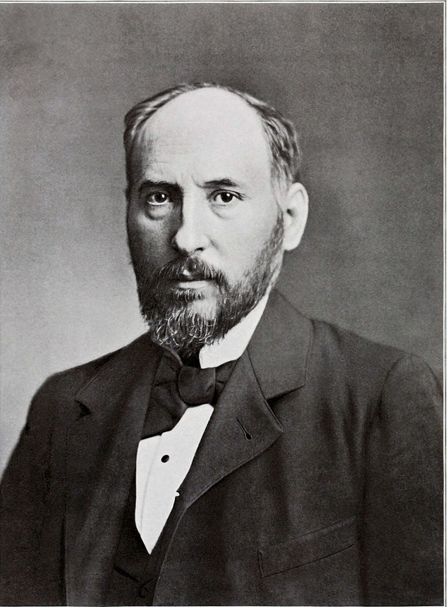
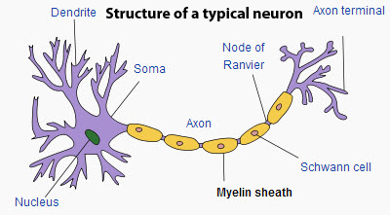

Slide 4
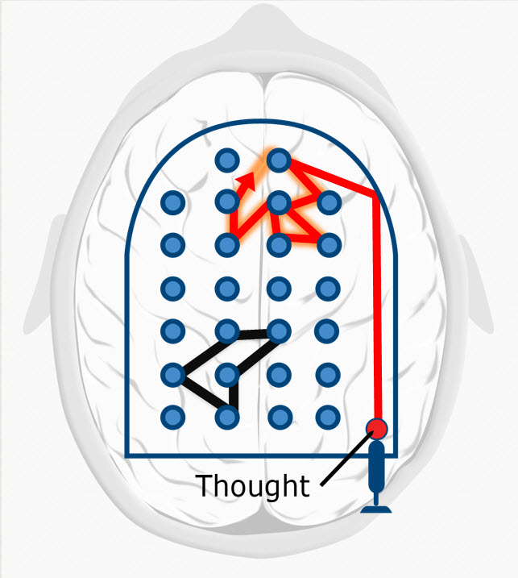
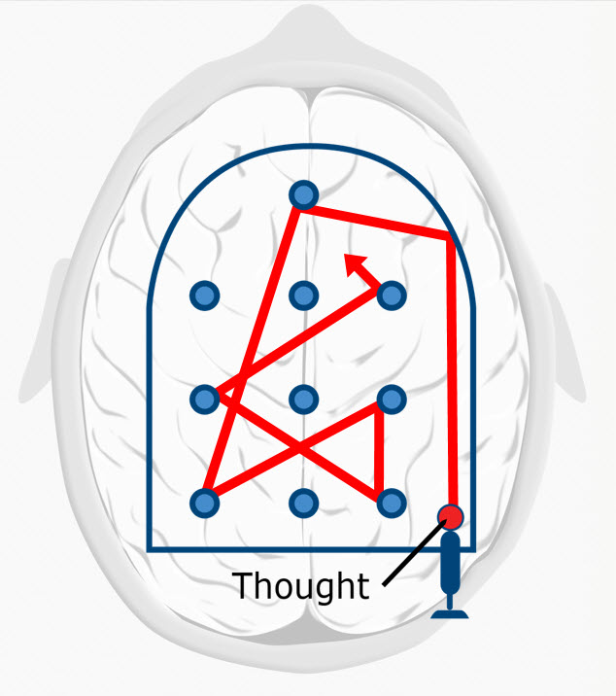

Slide 5

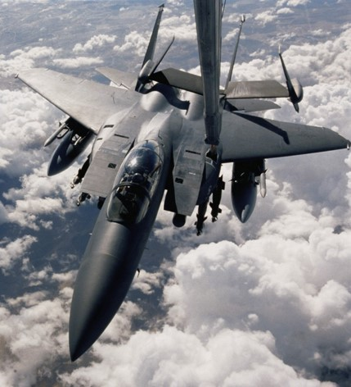
Hard start –
jump to easy

Slide 6
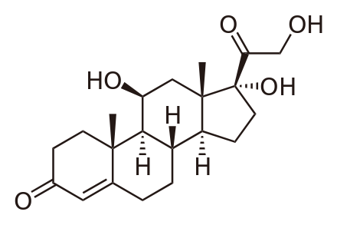
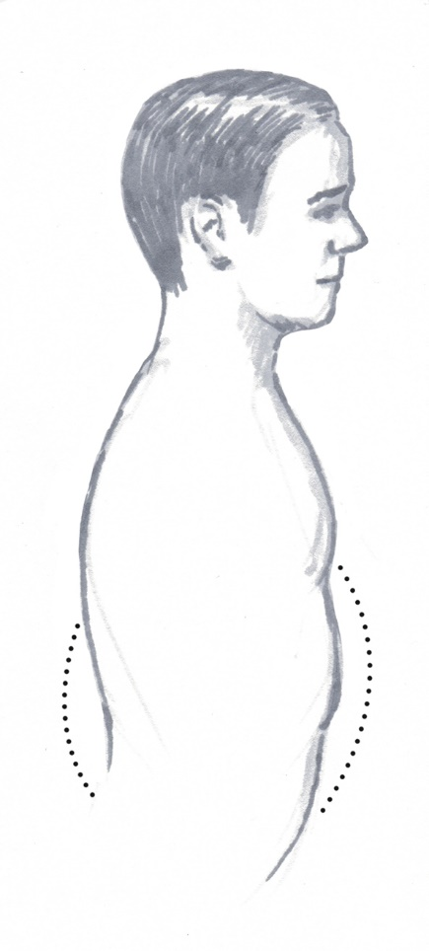
This test as made me afraid.
This test has got me determined to do my best!

Slide 7
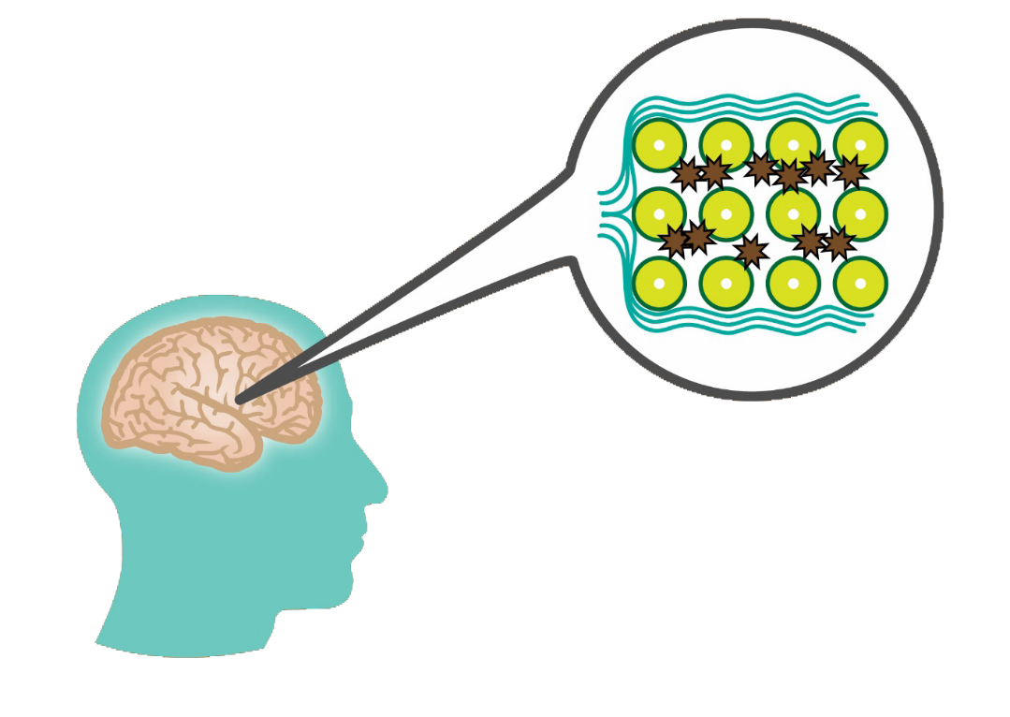

Slide 8
Illustration credits
Allegory of Music by Filippino Lippi, (between 1475 and 1500), http://en.wikipedia.org/wiki/Allegory#mediaviewer/File:Filippino_Lippi_001.jpg
Monkeys in a ring, from Berichte der Durstigen Chemischen Gesellschaft (1886), p. 3536; benzene ring, modified from http://en.wikipedia.org/wiki/File:Benzene-2D-full.svg
Water flow analogy for electrical current by Professor Richard Vawter, http://faculty.wwu.edu/vawter/PhysicsNet/Topics/DC-Current/WaterFlowAnalog.html.
Anonymous photo of Santiago Ramón y Cajal published by Clark University in 1899. http://en.wikipedia.org/wiki/Santiago_Ram%C3%B3n_y_Cajal#mediaviewer/File:Cajal-Restored.jpg
Structure of typical neuron, http://en.wikipedia.org/wiki/Myelin, Original uploader was Quasar Jarosz.
Clip art courtesy Microsoft Corporation
Focused and diffuse mode pinballs, ©Kevin Mendez, 2014.
Chemical structure of cortisol, by Calvero, http://en.wikipedia.org/wiki/Cortisol#mediaviewer/File:Cortisol2.svg
Breathing, ©Rachel Oakley, 2014.
Sleep image ©Kevin Mendez, 2014.

